Slide 1
The Complete Front-End Development course
Principles of building a better UI

Slide 2
Module 2
Web Design- Colours, Typography
Principles of a good User Interface (UI)
Principles of a good User Experience (UX)
Improving Accessibility
Implementing these principles in our website.

Slide 3
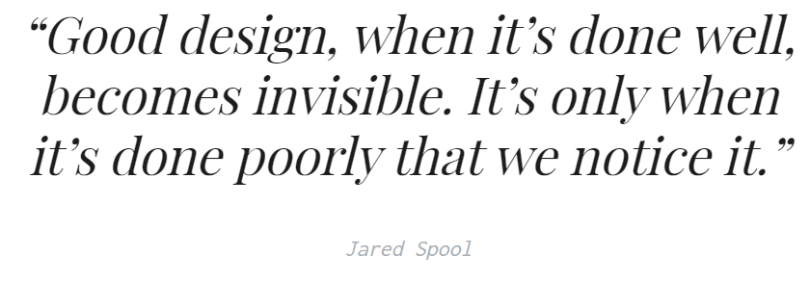

Slide 4
Introduction to web design
One of the cheapest ways to make your business look expensive is a good web design.
Aesthetic sense
Design should focus on experience and emotions
People scan websites, don’t read them!
Notes:
Aesthetic sense quality required from a designer as well as a Front End Engineer.
users remember experiences
We spend a lot of time online reading news, navigating websites and using web apps.
Unclickable links, unnecessary animations all put users off
Remember how social media websites which are simple are more user friendly as it doesn’t distract from content.

Slide 5


Color theory
The art and science of creating the right color palette for your website
Often designers will use scientific ways to combine colors
Notes:
https://color.adobe.com/create/color-wheel
Colorhunt.co

Slide 6
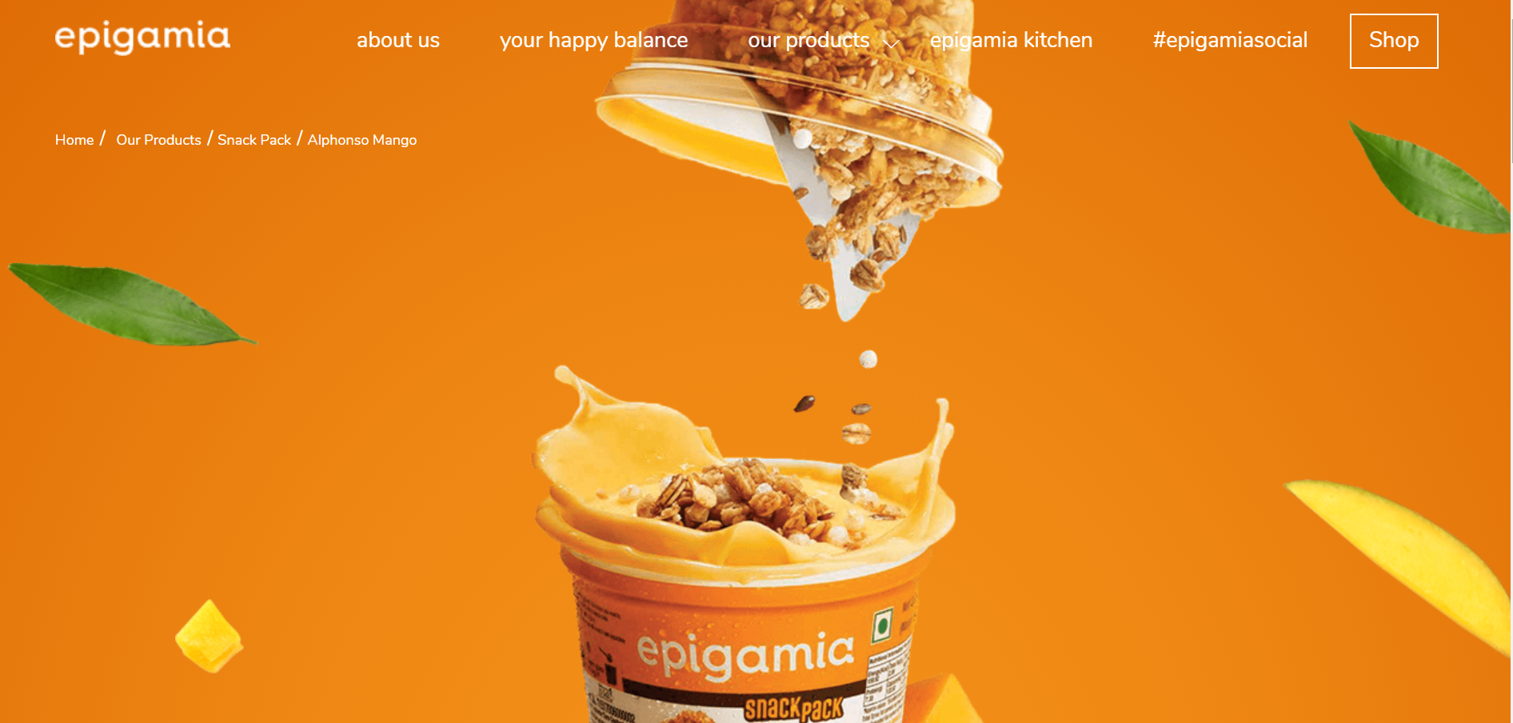

Slide 7
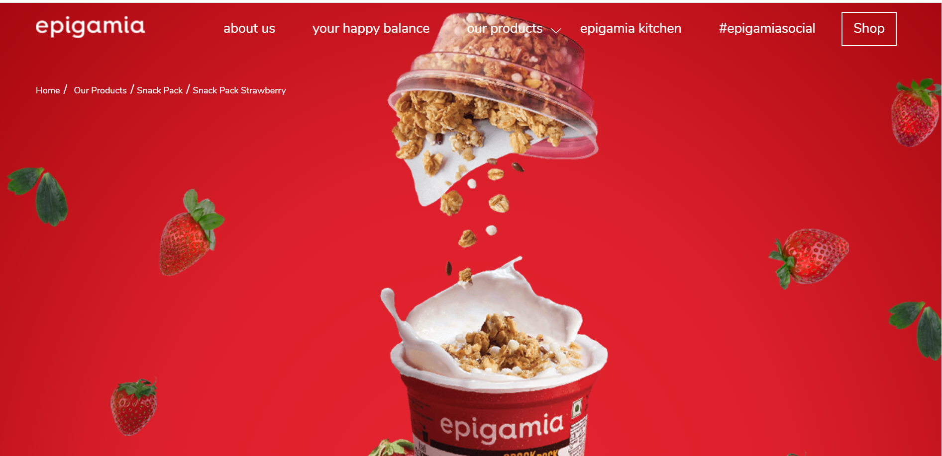

Slide 8
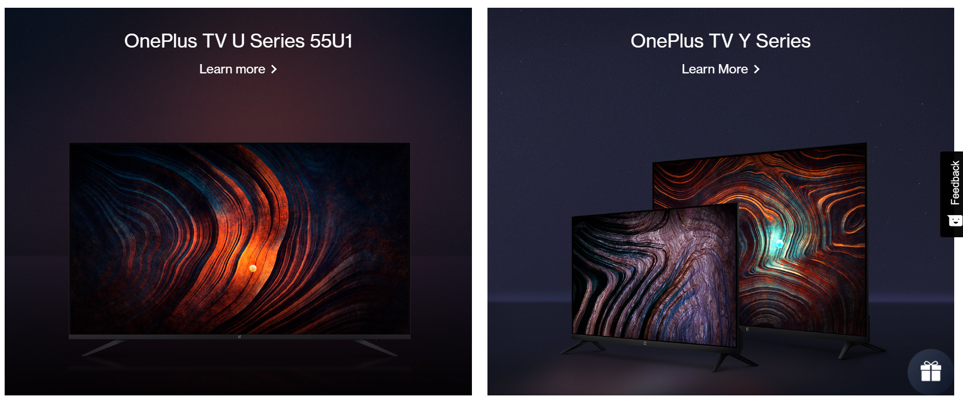

Slide 9
Red
Love, Energy, Intensity
Yellow
Joy, Intellect, Attention
Green
Freshness, Safety, Growth
Blue
Stability, Trust, Serenity
Purple
Royalty, Wealth, Feminity
Notes:
Bank and payment websites using blue for stability and security
Skill lync uses blue

Slide 10
Typography
Why is typography important?
Emotions are associated behind fonts
Serif
Sans Serif
Effect of fonts on time critical jobs
Notes:
Show the font effect html
Good font for a start up- skill lync
Serif- inspired by stone carvings, good for displaying architecture, legal systems… Further divided into four. Notice Vogue magazine being modern serif
Sans Serif- most startups like using it eg skill lync. Humanist is most readable. Most body text is sans serif
In time critical jobs, fonts for better readable saves time eg driving dashboards

Slide 11


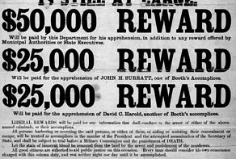

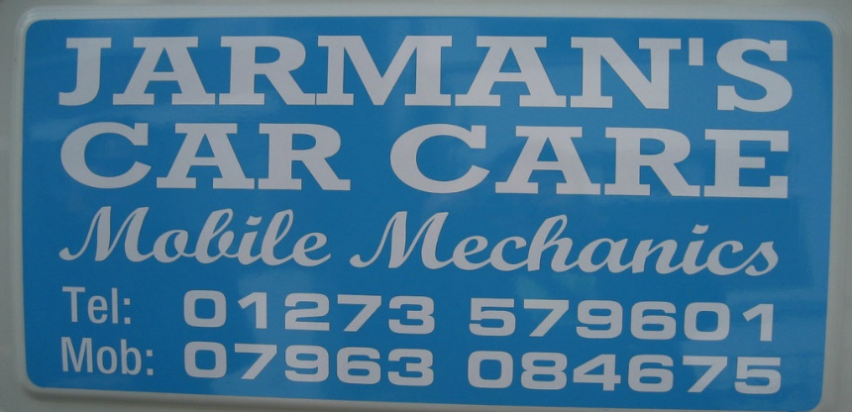

Notes:
Don’t use too many fonts in a single page- cluttered, unprofessional.
Find fonts with similar moods -https://larryjordan.com/articles/pick-fonts-for-emotion-and-power/

Slide 12
Good UI principles
What are design principles?
Widely applicable guidelines, best practices and considerations which designers apply
Responsive website design- Inclusive of all platforms
Notes:
Design principles are widely applicable laws, guidelines, biases and design considerations which designers apply with discretion.
Designers use principles such as visibility, findability and learnability to address basic human behaviors. We use some design principles to guide actions.

Slide 13
Naturalness
A Natural UI design is one that does not force the users to change their usual ways
Ecommerce website uses same flow as with any hypermarket task flow for the user.
Use of words, images and colors e.g. cart image
Notes:
According to the article by Ditte Mortensen, a natural UI design is one that does not force the users to change their usual ways of solving the issue significantly. It means that the messages and results produced by the application should not require additional explanations. It is also advisable to preserve the notation system and terminology used in this subject area.
The use of familiar to the user concepts and images creates an intuitive interface. It becomes a kind of “bridge” connecting the images of the real world with those actions and objects that a user has to manipulate. Users remember the action associated with a familiar object easily than they would remember the name of the command associated with that action.
“Until now, we have always had to adapt to the limits of technology and conform the way we work with computers to a set of arbitrary conventions and procedures. With Natural User Interface, computing devices will adapt to our needs and preferences for the first time and humans will begin to use technology in whatever way is most comfortable and natural for us.” —Bill Gates, co-founder of the multinational technology company Microsoft

Slide 14
User Control
Good UIs instill a sense of control in their users.
Keeping users in control makes them comfortable
For Google maps- provides controls, shows/hides zooming level
If you are embedding audio/video, make sure to give a control panel
Make actions reversible – be forgiving
Notes:
Control panel for video to turn it off or increase speed etc
This rule means that the user should always be able to quickly backtrack whatever they are doing. This allows users to explore the product without the constant fear of failure — when a user knows that errors can be easily undone, this encourages exploration of unfamiliar options. On the contrary, if a user has to be extremely careful with every action they take, it leads to a slower exploration and nerve-racking experience that no one wants. Eg undo operation in mailboxes
Humans are most comfortable when they feel in control of themselves and their environment. Thoughtless software takes away that comfort by forcing people into unplanned interactions, confusing pathways, and surprising outcomes.

Slide 15

Predictability
A crucial moment: The zero state
Using metaphors in the UI design allows users to create a connection between the real world and digital experiences.
Notes:
Eg recycle bin or physical card pic used at checkout

Slide 16
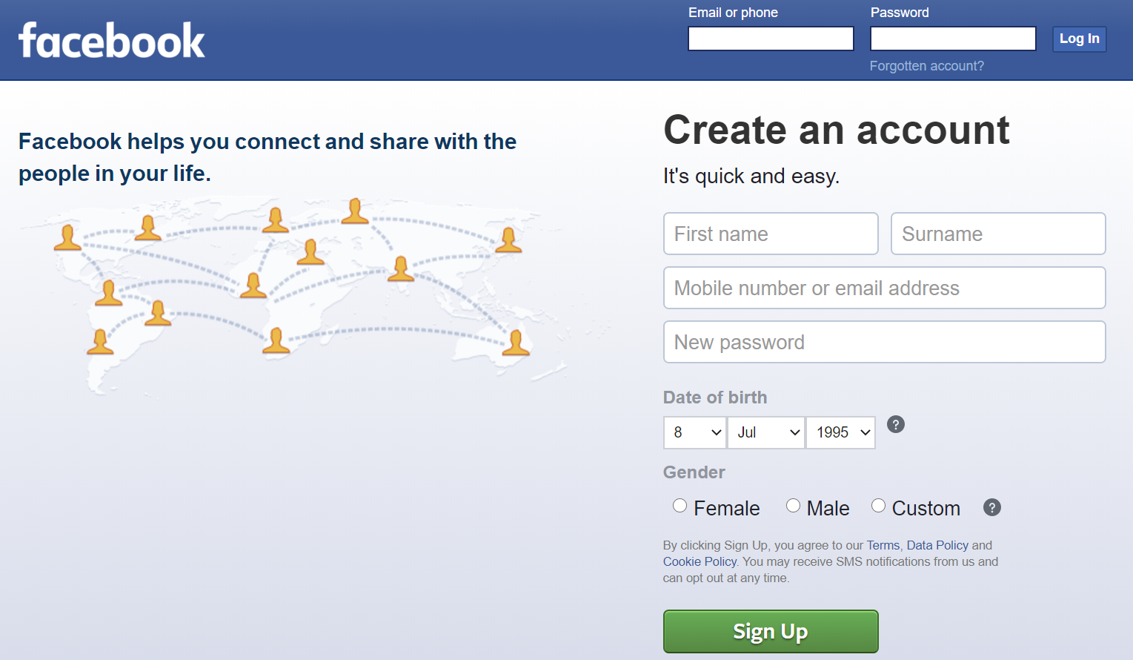

Slide 17
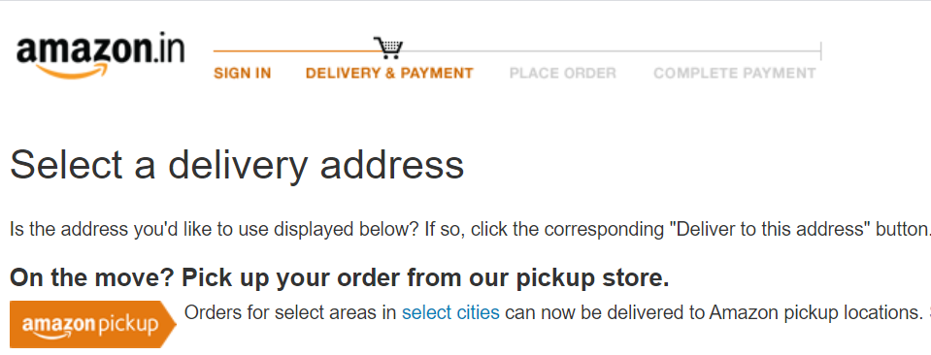
Predictability
Give easy navigation
Give visual cues

Slide 18
Flexibility and Efficiency
Font and Design customizations
Data Customizations
Customize user experience- hierarchy, layout, alignment, white space.
Efficiency- Scrolling is often faster than paging
Notes:
Use comic sans and colors for children
Eg of customization is medium website
One style for a particular audience. And different for different audience.

Slide 19
Error Prevention
Provide informative feedback- Help people inline
Prevent errors if possible; else warn users before they commit actions
Show the visibility of system status
Provide plain-language error messages to pinpoint problems and likely solutions.
Be polite in your error messages
Don’t make your problems the user’s issue
Notes:
Information feedback eg while filling a form
Warn before actions eg while creating new password
System status eg progress bars, percentage completion indicaions on uploads etc for user comfort
Eg don’t show 404, rather show normal English error. Eg google showing dinosaur image
Polite error msg eg linkedin or slack
Not a users problem eg form fields catering to your program for parsing it
Engineer for errors
Errors are inadvertent in the user journey. Bad error handling paired with useless error messages can fill users with frustration and lead them to abandon your app. A well-crafted error message, on the other hand, can turn a moment of frustration into a moment of conversion. An effective error message is a combination of explicit error notification together with hints for solving the problem.
Good UI has precise, polite, and constructive error messages. Even better than writing good error messages is having UI design that prevents a problem from occurring in the first place. Try to either eliminate error-prone conditions or check for them and present users with a confirmation dialog before they commit to the action. For example, Gmail prompts you when you forget to insert an attachment.
The best designs have excellent error recovery while trying to prevent users from making those errors in the first place. Error prevention in Gmail shows a pop-up if users forget to insert an attachment after referencing one.
I see too many obscure error messages which blame the users for the problem or fail to explain what the error is. Human tone and language will help users relate better to the situation and subsequently improve the user’s experience.
help is inline and contextual, available only when and where it is needed, hidden from view at all other times.

Slide 20
Clarity
Clarity is the first and most important job of any interface.
There should be no confusion.
Clarity inspires confidence and leads to further use.
Clarity over complexity
No visual clutter
Notes:
Clarity over complexity eg job applications
Avoid presenting too much information at one time on the screen. This results in visual clutter.
Clarity is the one of the key features any interface should possess.
The users need to understand what they interact with through the interface. Clarity is about giving users confidence and willingness to continue interacting with the interface. Many clear screens are better than one messy one.
While there is room for mystery and delayed gratification in interfaces, there is no room for confusion.

Slide 21
Visual Hierarchy
Use typography, colors, contrast to highlight important things
Have an easy-to-scan visual hierarchy that reflects users’ needs
Commonly used items handily available.
Notes:
Eg invitations to events

Slide 22
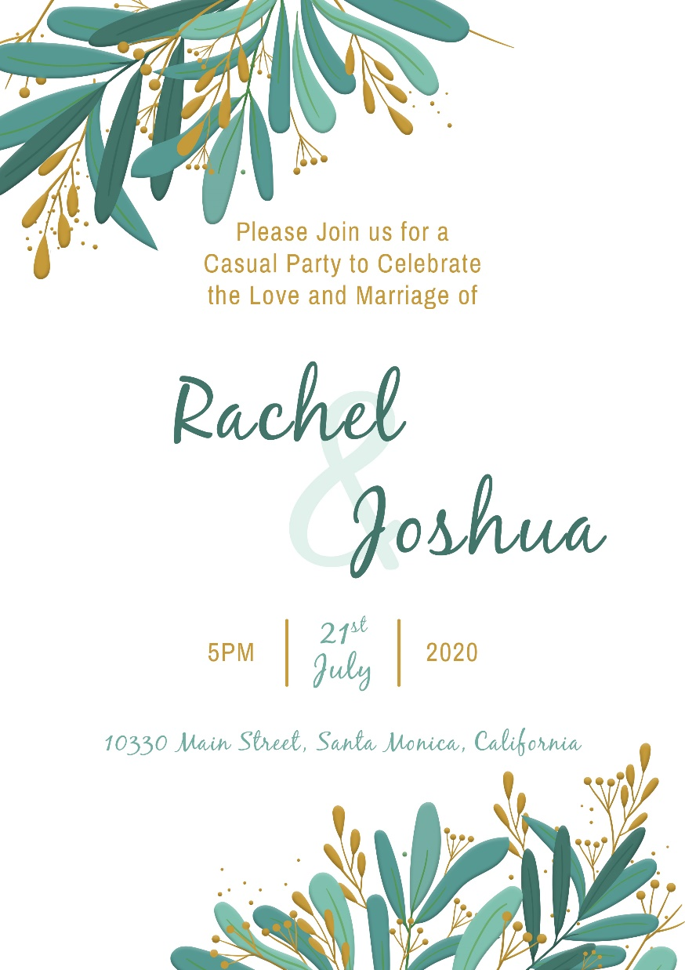
Use Typography- font weight, size to establish hierarchy

Slide 23
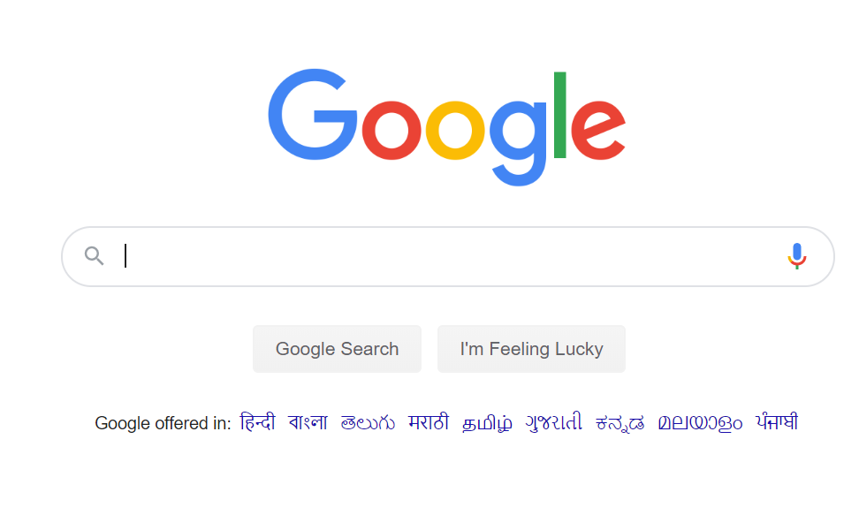
Why does google have such a big search button when other websites have very small at the top?

Slide 24
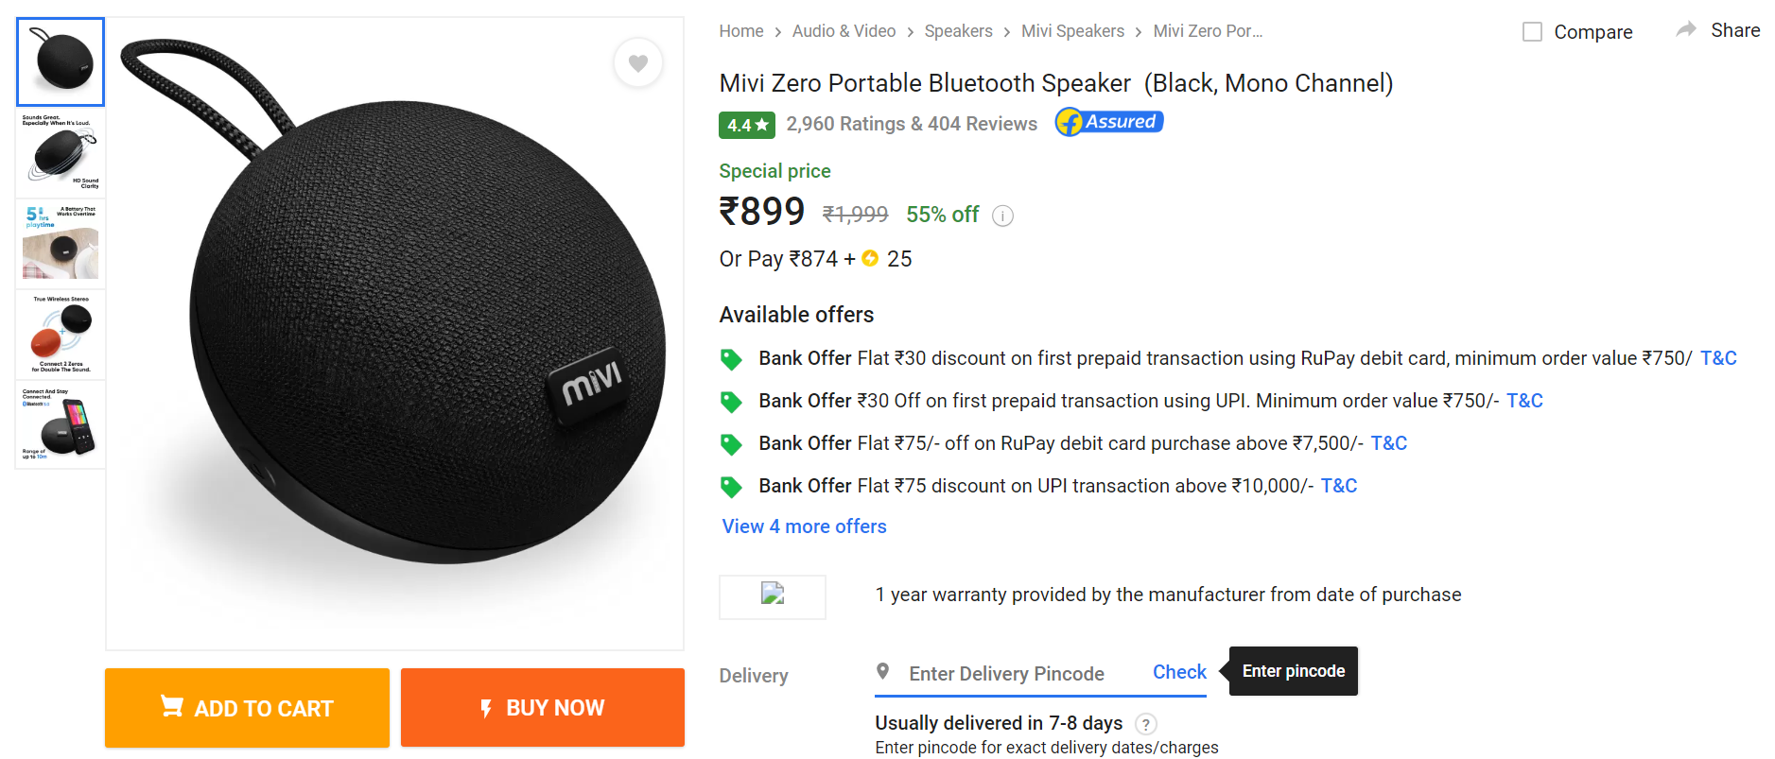
Use sizes of buttons to establish hierarchy

Slide 25
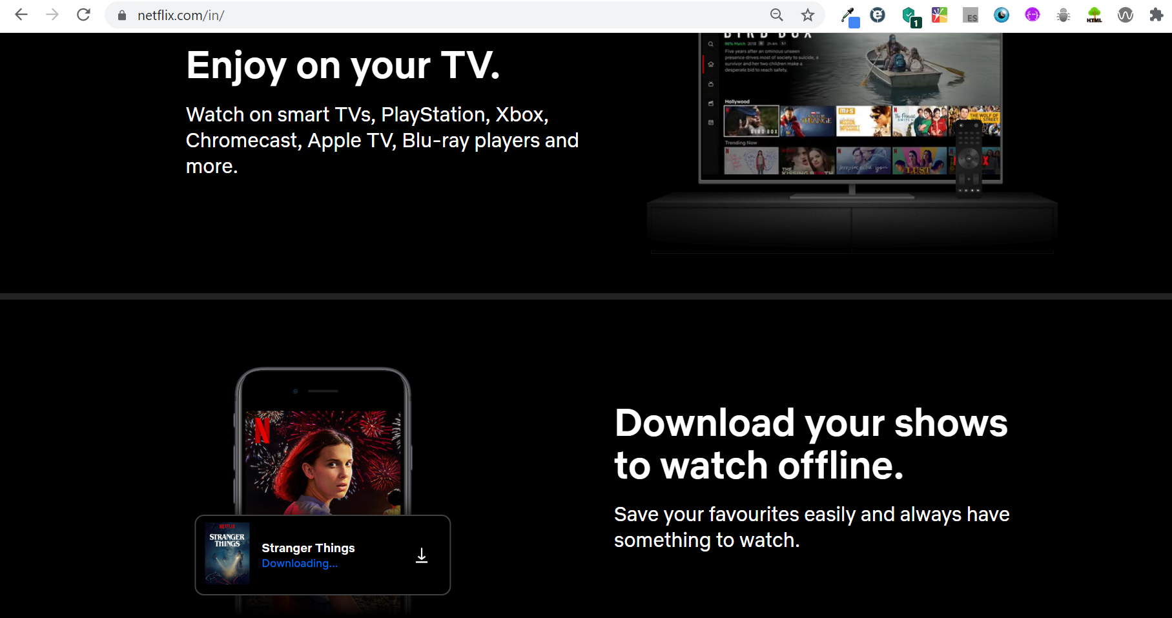
Layout for hierarchy
Make correct layout for establishing hierarchy
Don’t have too long lines nor too short eg Netflix website
Notes:
eg Wikipedia- bad design same layout throughout.

Slide 26
Visual Hierarchy
Alignment- Have same for title and body
Have the same indentation for everything.
Importance of white spacing/negative space
Notes:
Same indentation- Important for professional and pixel perfect with images etc

Slide 27
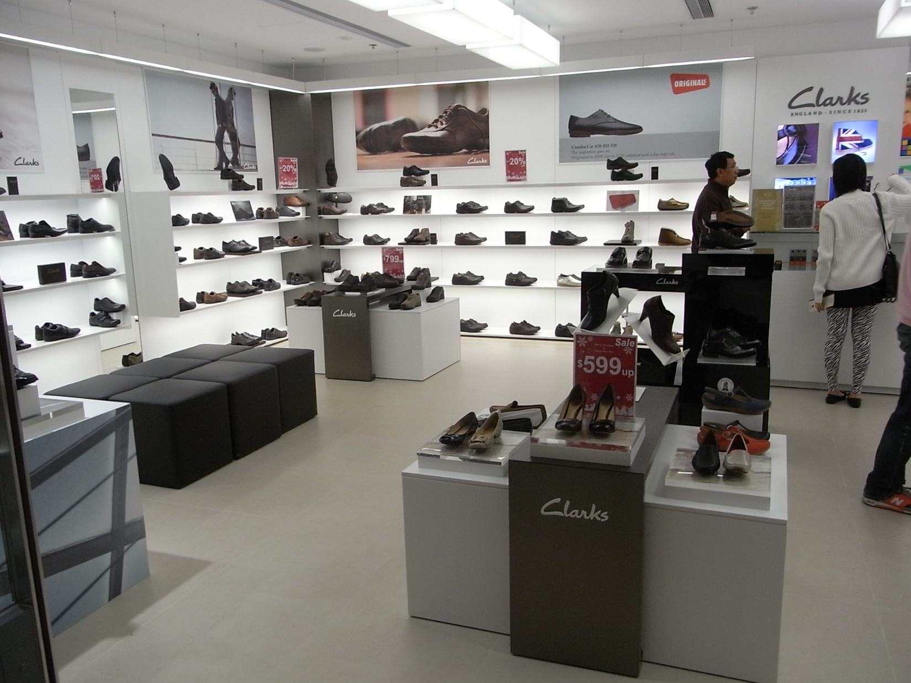

Slide 28
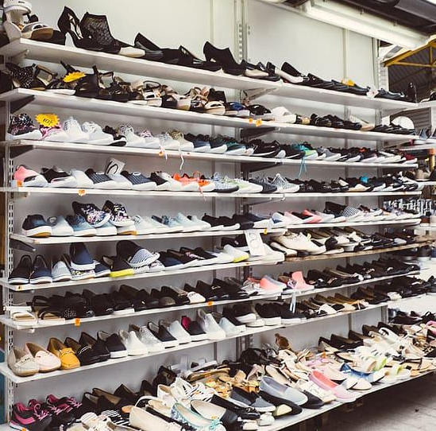

Slide 29


Slide 30
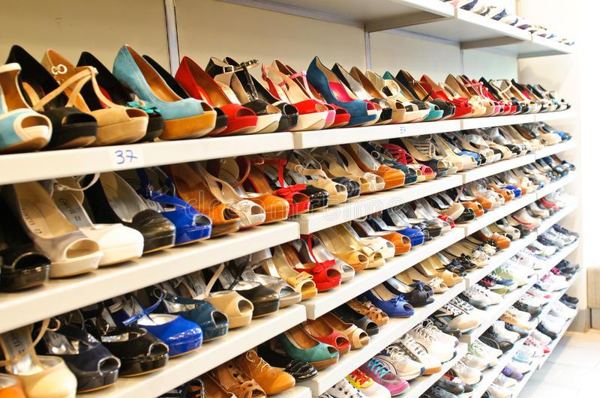

Slide 31
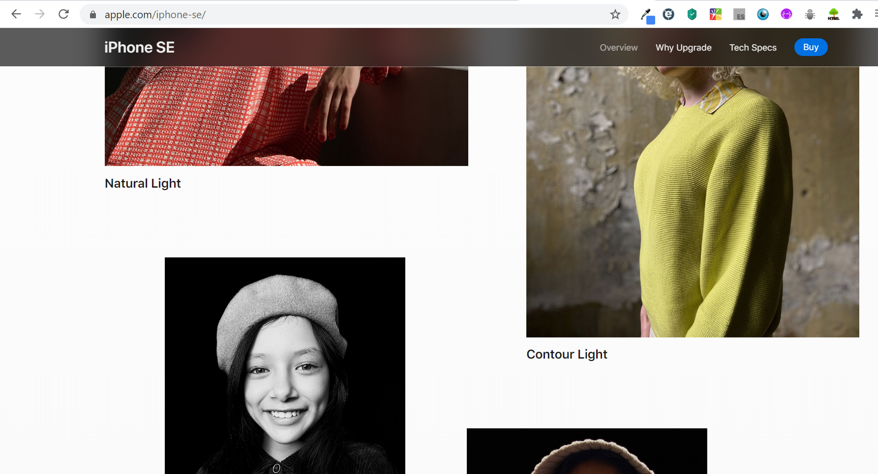
Why does apple use so much of spacing?

Slide 32
Progressive Disclosure
An ideal interface will defer final decisions to subsequent screens by progressively disclosing information.
If people are making a decision, show enough information to allow them the choice and then display additional information on a subsequent screen.
Don’t interrupt or give users obstacles – make obvious pathways which offer an easy ride.
Notes:
sites try to show everything all at once! — show only what is necessary on each screen.
There is still a misconception that every user will land on the homepage of a website — marketing, social media and people sharing links could bring a user to any page on your website. An ideal interface will defer final decisions to subsequent screens by progressively disclosing information.
When designing a user interface remember; if people are making a decision, show enough information to allow them the choice and then display additional information on a subsequent screen.
Show only what is necessary on each screen. If people are making a choice, show enough information to allow them the choice, then dive into details on a subsequent screen. Avoid the tendency to over-explain or show everything all at once. When possible, defer decisions to subsequent screens by progressively disclosing information as necessary. This will keep your interactions more clear.

Slide 33
Accommodate all types of users
Accommodate users with different skill levels
Don’t sacrifice expert users for an easy-to-use interface for novice or casual users
Make systems flexible so novices and experts can choose to do more or less on them.
Notes:
eg for Microsoft office there are menu bars as well as keyboard shortcuts, help bars, tutorials etc

Slide 34
Fitts' law
Your finger too big to tap on a button/checkbox?
Fitts Law states that the time to acquire a target is a function of the distance to and size of the target.
So large and closer targets for important functions
Reduce the total number of targets to accomplish a given task too!
Notes:
This means that it’s better to design large targets for important functions (big buttons are easier to interact with).
It’s also important to remember that the time required to acquire multiple targets is the sum of the time to acquire each. Thus, when working on UI design, to increase the efficiency of an interaction, try to not only reduce distances and increase target sizes, but also reduce the total number of targets that users must interact with to complete a given task.

Slide 35
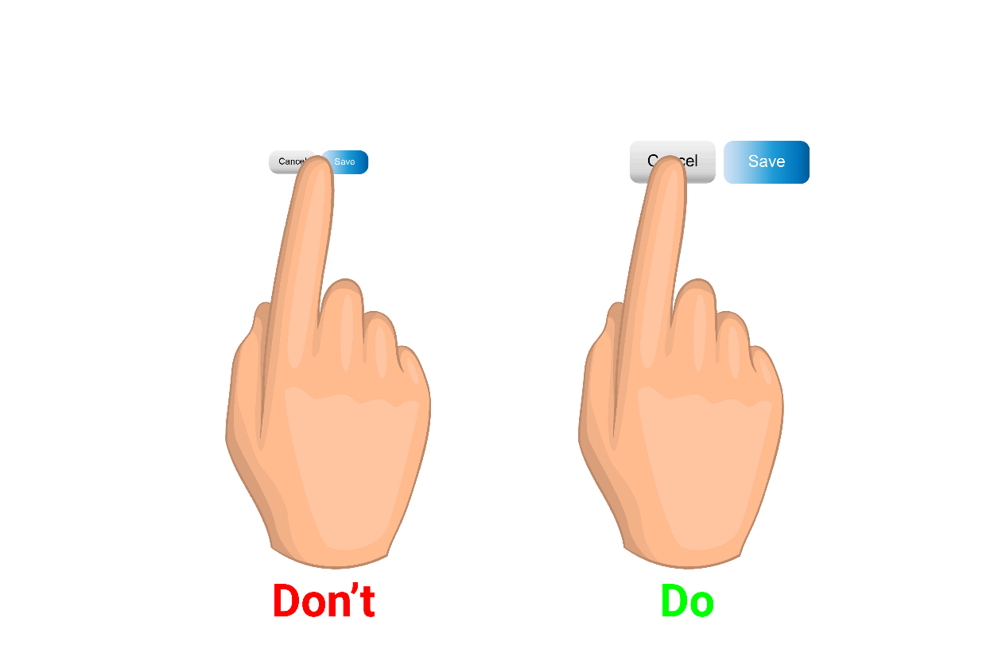

Slide 36
Protect the user’s work
Don’t ask users for data they’ve already entered
Don’t let users do the work again
Whether error is on their side or yours
Notes:
e.g. saving cards at checkout, addresses etc.
Don’t force users to have to repeat data they’ve previously entered. Users are easily annoyed by tedious data-entry sequences, especially when they have provided all the required information before. Good UI performs a maximum of work while requiring a minimum amount of information from users.
Ensure that users never lose their work. Users should not lose their work as a result of an error on their side (i.e. accidentally refresh a web page with a form that has user input), a system error, problems with an internet connection, or any other reason other than those that are completely unavoidable, like an unexpected power loss.

Slide 37
Design for Interaction
Create defaults that reduce the burden on the user.
Recognition over recall- give cues to establish a habit, don’t make users recall
Don’t make users remember information – keep options, etc. visible.
Notes:
By carefully thinking about and anticipating the goals people bring to your site, Eg prefilled form inputs
The primary purpose of an interface is to allow people interacting with the world, to match the system and the real world
Through the interface, we get access to services. Interfaces perform specific tasks, and their effectiveness is measurable. However, they may go beyond practical applications. The best interfaces are those that surprise, inspire, awaken feelings, strengthen the experience in interaction with the world.
Recognizing something is much easier than recalling it because recognition involves more cues in our brain (cues spread activation to related information in memory, and those cues help us remember information).
Designers can promote recognition in user interfaces by making information and functionality visible and easily accessible. Visual aids, such as tooltips and context-sensitive details, also help support users in recognizing information.

Slide 38
Focus on one action
Conserve attention at all costs
One primary action per screen
Keep secondary actions secondary eg share button.
Eliminate all elements that are not helping your users
Notes:
Every screen we design should support a single action of real value to the person using it. This makes it easier to learn, easier to use, and easier to add to or build on when necessary. Screens that support two or more primary actions become confusing quickly. Like a written article should have a single, strong thesis, every screen we design should support a single, strong action that is its raison d'etre.
Screens with a single primary action can have multiple secondary actions but they need to be kept secondary! The reason why your article exists isn't so that people can share it on Twitter…it exists for people to read and understand it. Keep secondary actions secondary by making them lighter weight visually or shown after the primary action has been achieved.

Slide 39
Grouping and Breakup
Cluster related objects together.
Proximity to establish grouping
Repetition of same style for grouping

Slide 40
Information Architecture
Be purposeful in page layout.
Consider the spatial relationships between items on the page and structure the page based on importance.

Slide 41
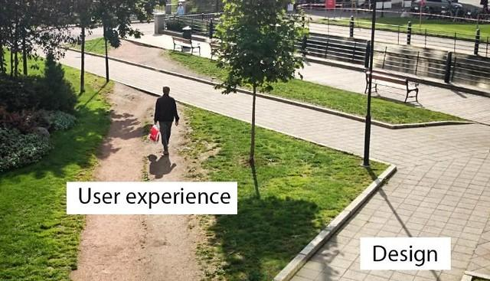
Good UX principles
What exactly is UX?

Slide 42
User research and Usability Testing
Your thoughts vs user behavior
Mobile version not too scaled down nor having little content to show
Styling can sometimes make your page less accessible so test with users and gain feedback

Slide 43
Usability
Simplicity- Design with aesthetics and minimalism in mind – don’t clutter with unnecessary items.
Usability first before design aesthetic

Slide 44
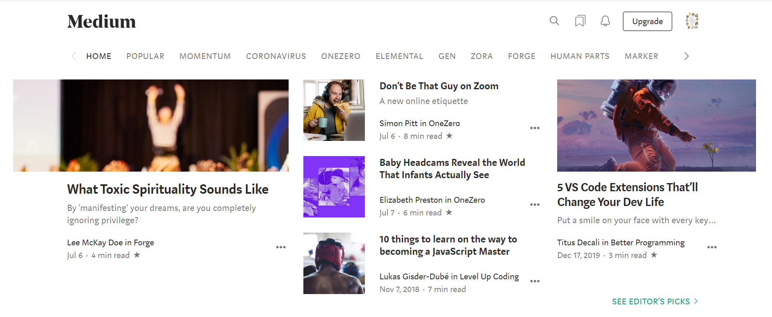

Slide 45
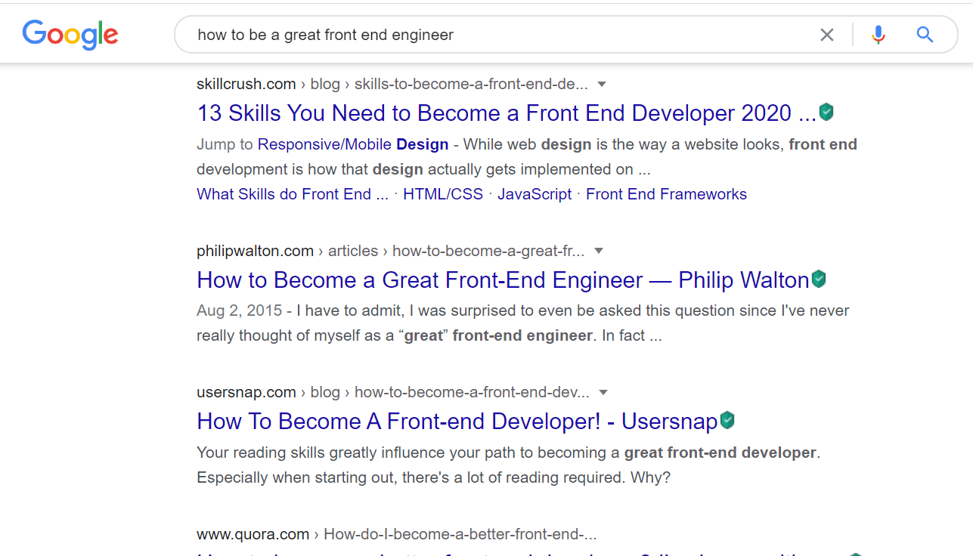
The F layout

Slide 46
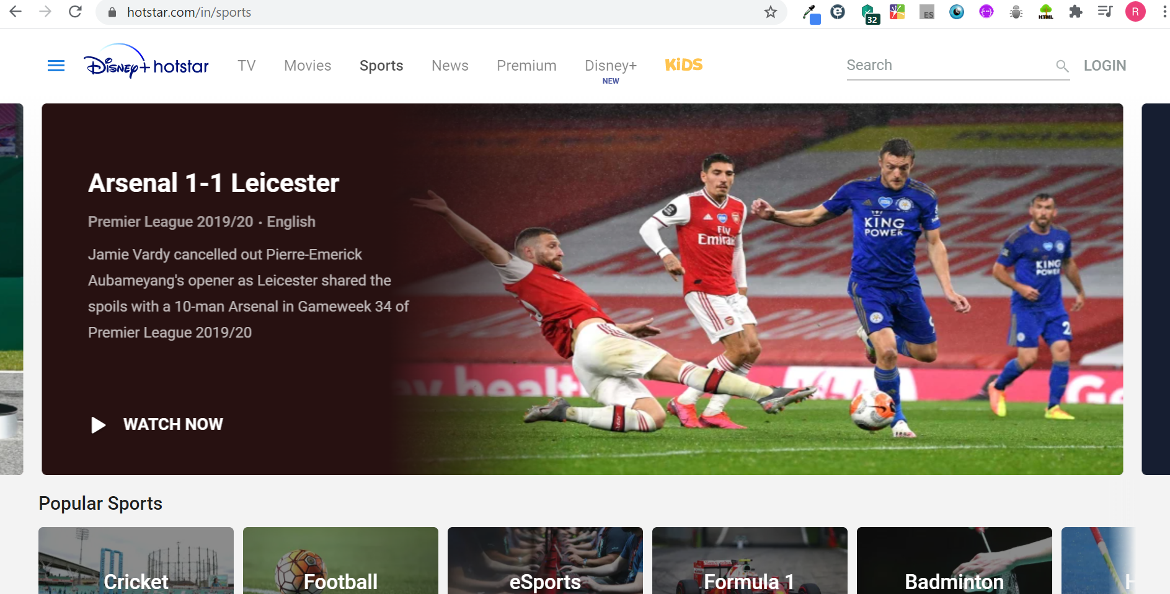
The Z layout
Notes:
E.g. facebook homepage

Slide 47
Consistency
Use common elements.
How would you feel driving a car a certain day whose break and accelerator is swapped positions?
Keep a single way of doing everything in your app
A consistent design is simpler for users
Same CSS, same layout

Slide 48
Consistency
Keep your design consistent
Nobody likes to relearn anything
Makes users confident in using your app
Be consistent with user expectations- least surprises!
Don’t hinder users with nice-to-haves unnecessarily.
Don’t reinvent user patterns
Don’t reinvent terminology e.g. use checkout instead of billing
Notes:
Eg cart is always on right top, so don’t it different in your ecommerce site

Slide 49
Dark patterns
The good, the bad and now the evil.
Beneficial for the company but not for the user
You click something or go a webpage for an intention, but you get into something else, will you trust that site again?
Notes:
Eg Showcasing grocery areas in banners by hypermarkets while infact being mostly full of sugaries and carbs
Be trustworthy and credible – identify yourself through your design to assure users and eliminate uncertainty.

Slide 50
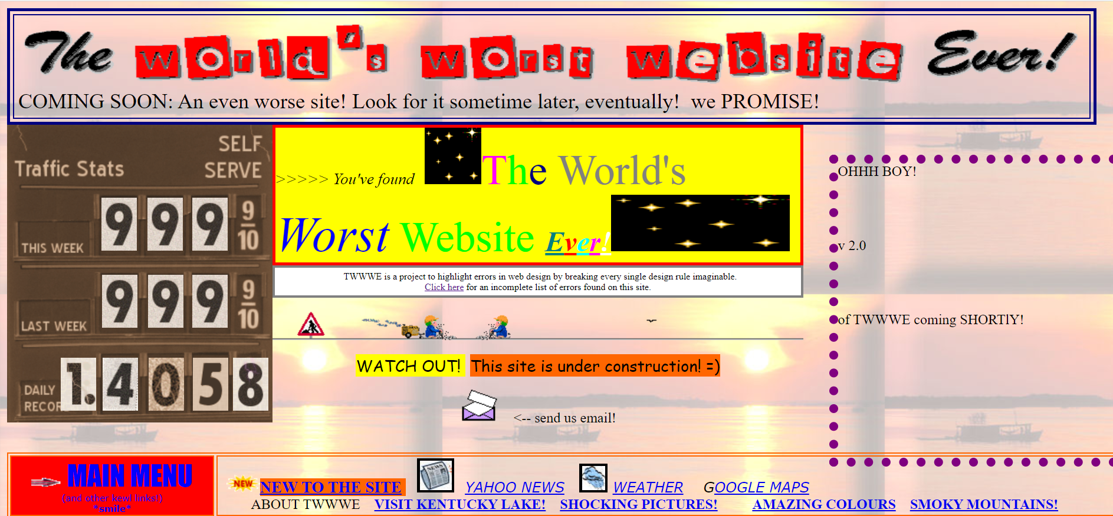
Notes:
https://www.theworldsworstwebsiteever.com/ tell them to go through all the problems in this website

Slide 51
Accessibility
Build for inclusion of all audience including disabled-
low vision, blindness, color blindness
hearing impairments
cognitive impairments
motor impairments

Slide 52
Visual disabilities
Anytime you want color to convey information in the interface, you should use other cues to convey the information to those who cannot see the colors.
Perceivable- Always provide text alternatives to your images.
Add content to your webpage via html, not via images etc for better accessibility
Use good color contrast for easy viewing
Continuously flashing on screen causes trouble
Notes:
Color is one of the elements of an interface that has a strong impact on accessibility. People perceive color differently — some users can see a full range of colors, but many people can only make out a limited range of colors.

Slide 53
Hearing Disabilities
Are you using music or listening modules for giving information in your website?
Do your videos include captioning?
Provide captions and transcripts for video and audio.

Slide 54
Motor disabilities
Slow response time
Do you require a steady hand?
Operable- Make sure everything is accessible with a keyboard as well not only mouse actions

Slide 55
Cognitive disabilities
Understandable-
Help user navigate to your page and give location of where they are
Use easy language
Information structure should be discernable
Make pages operate in predictable ways
Help users avoid and correct mistakes

Slide 56
Robust and accessible
Syntax errors even though not visually hampering, may break use of assistive technology and accessibility tools
Cool styles should not make your page less accessible
Use correct semantic markups.
Refactor your HTML and make necessary CSS changes
Notes:
eg use figure tag.
Check your webpage and various webpages using wave extension

Slide 57
ARIA (Accessible Rich Internet Applications)
What is assistive technology?
What is affordance?
What is a screen reader?
What is ARIA?
Notes:
Assistive technology is an umbrella term for devices, software, and tools that help any person with a disability complete a task.
An affordance is any object that offers, or affords, its user the opportunity to perform an action. The better the affordance is designed, the more obvious or intuitive its use. Perceived affordances such as buttons are an example. That way, we put users in control in seamless experiences.
One popular type of assistive technology is the screen reader, a program that enables visually impaired people to use computers by reading screen text aloud in a generated voice. The user can control what is read by moving the cursor to a relevant area with the keyboard.
https://www.w3.org/TR/wai-aria/

Slide 58
ARIA
All html elements have
Roles
Properties
States
One of the core aspects of the ARIA system is its collection of roles.
ARIA Labels and Descriptions- aria-labelledby, aria-describedby
Role, name, value, state is imp for screen readers!
Notes:
role="checkbox“
aria-labelledby allows us to specify the ID of another element in the DOM as an element's label.

Slide 59
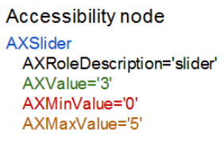
ARIA
ARIA can add extra label and description text that is only exposed to assistive technology APIs.
Express semantic relationships between elements.
DOM as accessibility nodes
Notes:
aria-label="screen reader only label“
<div role="scrollbar" aria-controls="main"></div> <div id="main"> . . . </div>

Slide 60
Using keyboard with ARIA
Be careful when changing the visual position of elements on screen using CSS e.g. float.
This can cause the tab order to jump around, confusing users who rely on the keyboard.
Using tab-index
Notes:
https://developers.google.com/web/fundamentals/accessibility/focus/using-tabindex

Slide 61
Coding Principles
DRY- Don’t repeat yourself
KIS- Keep it simple
Less is More
Adhere to w3c standards for future compatibility with newer browsers, accessibility and maintainable code
Responsive web design
Notes:
Use “less is more” – make everything count in the design. If functional and aesthetic elements don’t add to the user experience, forget them.

Slide 62
Prioritise performance
Be careful which properties you animate; some are more expensive than others.
Ensure that you know the impact of animating a given CSS property.
Animating properties that change the geometry of the page (layout) are particularly expensive.
Where you can, stick to changing transforms and opacity.
Use ”will-change” to ensure that the browser knows what you plan to animate.
Notes:
Take care that your animations don’t cause performance issues
.box { will-change: transform, opacity; }

Slide 63
Summary
Color theory
Typography
UI principles
UX principles
Coding principles
Accessibility
ARIA

Slide 64
Motivational tip
Be Sensitive
Diversity and Inclusion
Integrity as a virtue
Respect and a craving for learning as a developer
Networking to increase your influence

Slide 65
Assignment
Answer the following questions-
What are the various tools you can use to check if a website is accessible and/or mobile friendly?
How to you conduct user research and usability testing?
How do you perform accessibility testing?
What is WCAG?
What are the differences between A, AA, and AAA compliance?
Aside from screen readers, what other assistive technologies can be affected by use of ARIA? How?

Slide 66
Assignment
Add ARIA code in your webpage created thus far.
Create a 3 page report on how your webpage conforms to all the principles we have discussed in our module. If it doesn’t then make changes in your site so that it does and include that change in your report.

